Slide 1


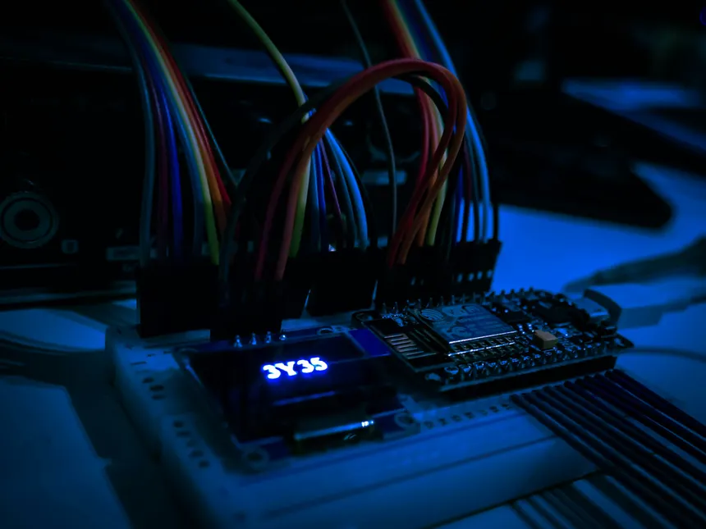
DCLab/Control System Crash Course
Microcontroller and Pulse-Width Modulation
An Introduction to Microcontroller and How they work
Session 01
DCLab/Control System Crash Course
>_ terminal gremlin (c-lydia ^_^)
Notes:
DIRECT EDIT VERSION: All visible artwork is on this slide. Click logos, labels, footer text, rules and panels directly. Text uses ordinary text boxes. Use the Selection Pane for small objects; items are named TEXT / LOGO / SHAPE. Duplicate a complete slide to reuse the design. New Slide layouts supply only basic placeholders. Background colour: Format Background / Slide Properties.
START HERE. Duplicate the slide you need to retain all editable elements. Replace bracketed text. Use the picture placeholder icon to insert your own photo; crop to fill or fit as needed. Click a logo directly to move, resize, delete or replace its picture. All logos are original unmodified artwork. Titles use Noto Sans Mono, body text Ubuntu Sans; install these or substitute your preferred fonts consistently. 16:9 format.

Slide 2
00 / Contents
Contents
01
Why Electronics?
How electronics and Control Systems are connected
02
Microcontroller
Microcontroller Architecture and Peripheral
03
PWM and LEDC
Basic of PWM and LED Control Peripheral
04
Implementation
Connecting the Theory to Physical System
DCLab/Control System Crash Course
>_ terminal gremlin (c-lydia ^_^)
Notes:
DIRECT EDIT VERSION: All visible artwork is on this slide. Click logos, labels, footer text, rules and panels directly. Text uses ordinary text boxes. Use the Selection Pane for small objects; items are named TEXT / LOGO / SHAPE. Duplicate a complete slide to reuse the design. New Slide layouts supply only basic placeholders. Background colour: Format Background / Slide Properties.
Use four actions with visible outcomes. Replace the verbs if your session has a different rhythm. Keep detail in speaker notes.

Slide 3
01 / Why Electronics?
>_
What would happen when we try to control an LED without actually understanding how electronics works?
Can motors behave like an LED? Not Excatly, but Both would cause Danger!!!
DCLab/Control System Crash Course
>_ terminal gremlin (c-lydia ^_^)
Notes:
DIRECT EDIT VERSION: All visible artwork is on this slide. Click logos, labels, footer text, rules and panels directly. Text uses ordinary text boxes. Use the Selection Pane for small objects; items are named TEXT / LOGO / SHAPE. Duplicate a complete slide to reuse the design. New Slide layouts supply only basic placeholders. Background colour: Format Background / Slide Properties.
Use the chapter title as a question. Pause for predictions. This dark transition is also useful before a live demo.

Slide 4
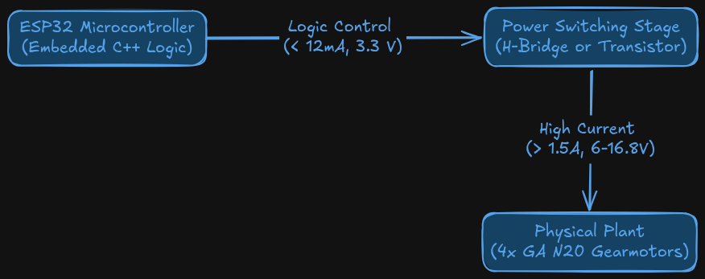
01 / Why Electronics?
The Current and Voltage Gap
What Could Go wrong?
> Electrical Destruction
Thermal Overcurrent
Inductive Kickback
Do NOT connect the load directly to a microcontroller pins
DCLab/Control System Crash Course
>_ terminal gremlin (c-lydia ^_^)
Notes:
DIRECT EDIT VERSION: All visible artwork is on this slide. Click logos, labels, footer text, rules and panels directly. Text uses ordinary text boxes. Use the Selection Pane for small objects; items are named TEXT / LOGO / SHAPE. Duplicate a complete slide to reuse the design. New Slide layouts supply only basic placeholders. Background colour: Format Background / Slide Properties.
Use the photo or diagram as the evidence. The left column should explain how to read it. Picture space is approximately 16:9. Keep the source in the caption or notes.

Slide 5
01 / Why Electronics
Logic Level Domains and Signal Translation
3.3V
CMOS Logic Domain
ESP32 GPIO Pins Input
5V
TTL Domain
Sensors and Legacy Peripheral
6V
Motor Drive
Isolated and Regulated Motor Driver Rail
14.8+V
Battery Pack
Energy Storage for all Components
DCLab/Control System Crash Course
>_ terminal gremlin (c-lydia ^_^)
Notes:
DIRECT EDIT VERSION: All visible artwork is on this slide. Click logos, labels, footer text, rules and panels directly. Text uses ordinary text boxes. Use the Selection Pane for small objects; items are named TEXT / LOGO / SHAPE. Duplicate a complete slide to reuse the design. New Slide layouts supply only basic placeholders. Background colour: Format Background / Slide Properties.
Use four actions with visible outcomes. Replace the verbs if your session has a different rhythm. Keep detail in speaker notes.

Slide 6
01 / Why Electronics?
Grounding, Return Paths, and Decoupling
Grounding
Constraints
When 2 subsystems exchange logical signals, they must share a ground reference.
Without it the signal defined as 3.3 V by the transmitter has an undefined, floating voltage potential at the receiver.
Ground loop Interference
  High-frequency ground bounce and inductive noise are introduced by motor
Separation Rule
  Motor path requires short paths, heavy ground wire (AWG 18 or 20), and terminated directly at power supply or screw terminal star ground
Decoupling Capacitors
  Needs capacitors (ceramic and electrolytic) to smooth high-frequency noise and buffer transient supply dips
Dclab/Control System crash Course
>_ terminal gremlin (c-lydia ^_^)
Notes:
DIRECT EDIT VERSION: All visible artwork is on this slide. Click logos, labels, footer text, rules and panels directly. Text uses ordinary text boxes. Use the Selection Pane for small objects; items are named TEXT / LOGO / SHAPE. Duplicate a complete slide to reuse the design. New Slide layouts supply only basic placeholders. Background colour: Format Background / Slide Properties.
Two independent picture placeholders. Use identical crops/scales for comparisons. Suitable for oscilloscope captures, wiring changes or debug output.

Slide 7
01 / Why Electronics?
Grounding, Return Paths, and Decoupling
Grounding
Constraints
When 2 subsystems exchange logical signals, they must share a ground reference.
Without it the signal defined as 3.3 V by the transmitter has an undefined, floating voltage potential at the receiver.
Ground loop Interference
  High-frequency ground bounce and inductive noise are introduced by motor
Separation Rule
  Motor path requires short paths, heavy ground wire (AWG 18 or 20), and terminated directly at power supply or screw terminal star ground
Decoupling Capacitors
  Needs capacitors (ceramic and electrolytic) to smooth high-frequency noise and buffer transient supply dips
Dclab/Control System crash Course
>_ terminal gremlin (c-lydia ^_^)
Notes:
DIRECT EDIT VERSION: All visible artwork is on this slide. Click logos, labels, footer text, rules and panels directly. Text uses ordinary text boxes. Use the Selection Pane for small objects; items are named TEXT / LOGO / SHAPE. Duplicate a complete slide to reuse the design. New Slide layouts supply only basic placeholders. Background colour: Format Background / Slide Properties.
Two independent picture placeholders. Use identical crops/scales for comparisons. Suitable for oscilloscope captures, wiring changes or debug output.

Slide 8
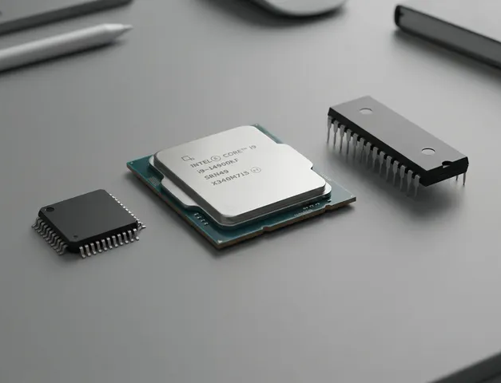
02 / Microcontroller
CPU, MPU, and MCU
01
Central Processing Unit (CPU)
The ALU and instruction execution pipeline
02
Microprocessor (MPU)
A high-performance processor, running heavy computation but lacks deterministic, hard real-time pin timing
03
Microntroller (MCU)
A self-contained SoC integrating CPU with high-speed generation and dedicated hardware peripheral, providing deterministic real-time control
DCLab/Control System Crash Course
>_ terminal gremlin (c-lydia ^_^)
Notes:
DIRECT EDIT VERSION: All visible artwork is on this slide. Click logos, labels, footer text, rules and panels directly. Text uses ordinary text boxes. Use the Selection Pane for small objects; items are named TEXT / LOGO / SHAPE. Duplicate a complete slide to reuse the design. New Slide layouts supply only basic placeholders. Background colour: Format Background / Slide Properties.
Insert a photo. Move the three numbered markers onto the relevant hardware features. They are ordinary editable shapes, separate from the picture placeholder. Use one clear connection per callout. Validate actual wiring against your hardware documentation.

Slide 9
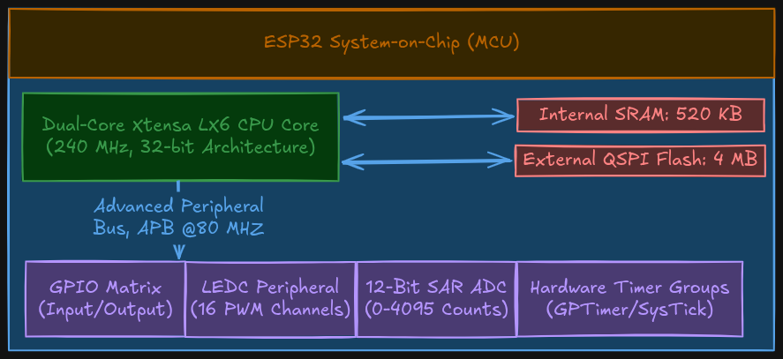
02 / Microcontroller
ESP32 Architecture
DCLab/Control System Crash Coourse
>_ terminal gremlin (c-lydia ^_^)
Notes:
DIRECT EDIT VERSION: All visible artwork is on this slide. Click logos, labels, footer text, rules and panels directly. Text uses ordinary text boxes. Use the Selection Pane for small objects; items are named TEXT / LOGO / SHAPE. Duplicate a complete slide to reuse the design. New Slide layouts supply only basic placeholders. Background colour: Format Background / Slide Properties.
Best for circuit diagrams, timing plots, architecture exports and screenshots. Use Fit rather than Fill when cropping would hide labels. Prefer the editable architecture layout when creating a new diagram.

Slide 10
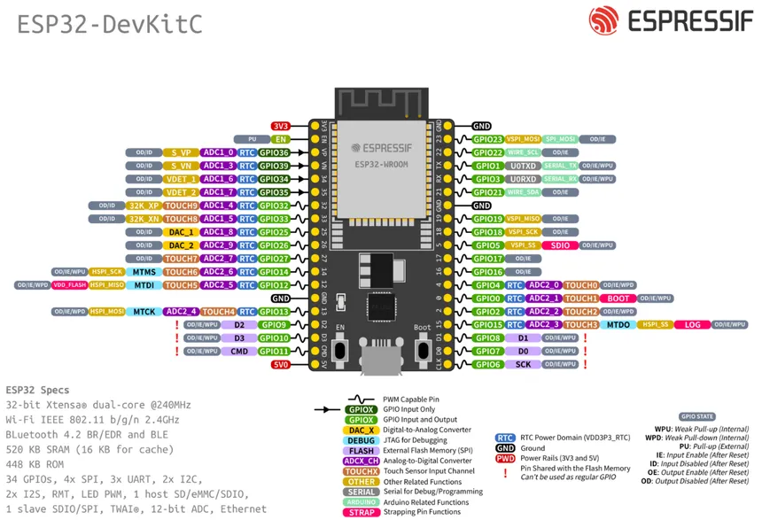
02 / Microcontroller
GPIO Matrix
01
GPIO 0-33
Standard bidirectional pins with fully configurable features
02
Input-Only
Lacks internal output driver and pullup or pulldown resistors
03
Boot Strapping
Determine boot mode
DCLab/Control System Crash Coourse
>_ terminal gremlin (c-lydia ^_^)
Notes:
DIRECT EDIT VERSION: All visible artwork is on this slide. Click logos, labels, footer text, rules and panels directly. Text uses ordinary text boxes. Use the Selection Pane for small objects; items are named TEXT / LOGO / SHAPE. Duplicate a complete slide to reuse the design. New Slide layouts supply only basic placeholders. Background colour: Format Background / Slide Properties.
Best for circuit diagrams, timing plots, architecture exports and screenshots. Use Fit rather than Fill when cropping would hide labels. Prefer the editable architecture layout when creating a new diagram.

Slide 11
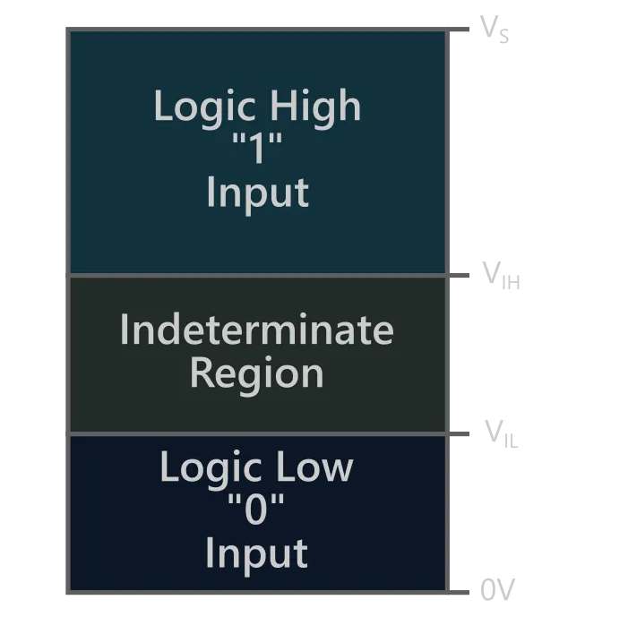
02 / Microcontroller
Floating Inputs
Floating Inputs
Pull Resistors
An input pins without pull resistors can have high-input impedance state which causes electromagnetic radiation couples capacitively into the pin gate, so the logic level oscillate unpredictably
Input pullup
  Connects internal resistors to HIGH
  pin defaults to logic HIGH
  Ground pulls the pin to logic Low when active (active low)
Input pulldown
  Connects internal resistor to LOW
  Pin defaults to LOW
  When active, the pin is HIGH (active high)
Dclab/Control System crash Course
>_ terminal gremlin (c-lydia ^_^)
Notes:
DIRECT EDIT VERSION: All visible artwork is on this slide. Click logos, labels, footer text, rules and panels directly. Text uses ordinary text boxes. Use the Selection Pane for small objects; items are named TEXT / LOGO / SHAPE. Duplicate a complete slide to reuse the design. New Slide layouts supply only basic placeholders. Background colour: Format Background / Slide Properties.
Two independent picture placeholders. Use identical crops/scales for comparisons. Suitable for oscilloscope captures, wiring changes or debug output.

Slide 12
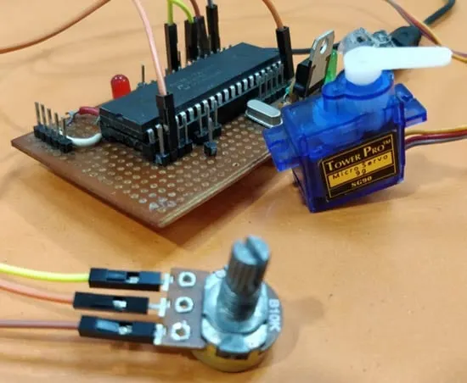
03 / Pulse-Width Modulation and LEDC
What is Pulse-Width Modulation?
A Method for controlling analog power delivery to motors and actuators using binary digital outputs
How?
By rapidly toggle a pin between LOW and HIGH at a constant carrier frequency
DCLab/Control System Crash Course
>_ terminal gremlin (c-lydia ^_^)
Notes:
DIRECT EDIT VERSION: All visible artwork is on this slide. Click logos, labels, footer text, rules and panels directly. Text uses ordinary text boxes. Use the Selection Pane for small objects; items are named TEXT / LOGO / SHAPE. Duplicate a complete slide to reuse the design. New Slide layouts supply only basic placeholders. Background colour: Format Background / Slide Properties.
Duplicate this slide for an answer reveal. Keep the answer in speaker notes on the question slide. Replace the figure with a small trace, code excerpt or image; use a code layout for longer snippets.

Slide 13
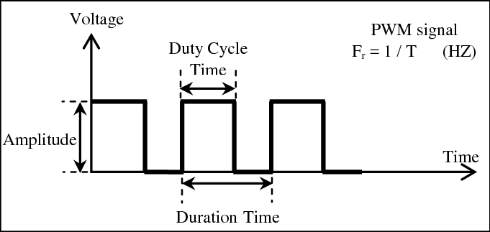
03 / Pulse-Wdith Modulation and LEDC
PWM Waveform
DCLab/Control System Crash Coourse
>_ terminal gremlin (c-lydia ^_^)
Notes:
DIRECT EDIT VERSION: All visible artwork is on this slide. Click logos, labels, footer text, rules and panels directly. Text uses ordinary text boxes. Use the Selection Pane for small objects; items are named TEXT / LOGO / SHAPE. Duplicate a complete slide to reuse the design. New Slide layouts supply only basic placeholders. Background colour: Format Background / Slide Properties.
Best for circuit diagrams, timing plots, architecture exports and screenshots. Use Fit rather than Fill when cropping would hide labels. Prefer the editable architecture layout when creating a new diagram.

Slide 14
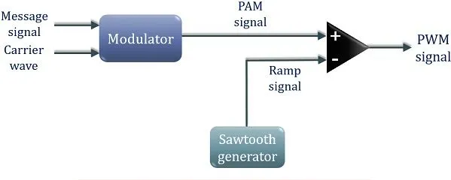
03 / Pulse-Width modulation and LEDC
PWM Carrier Period and Carrier Frequency
$T=T_{ON}+T_{OFF}=\frac{1}{f_{PWM}}$
Carrier Period: the duration of one complete waveform cycle
Carrier Frequency: the pulse repetition rate per second
DCLab/Control System Crash Course
>_ terminal gremlin (c-lydia ^_^)
Notes:
DIRECT EDIT VERSION: All visible artwork is on this slide. Click logos, labels, footer text, rules and panels directly. Text uses ordinary text boxes. Use the Selection Pane for small objects; items are named TEXT / LOGO / SHAPE. Duplicate a complete slide to reuse the design. New Slide layouts supply only basic placeholders. Background colour: Format Background / Slide Properties.
Simple equation is editable text. For fractions, matrices and advanced notation, replace it with Insert > Equation in PowerPoint or Insert > Object > Formula in LibreOffice. Keep variable definitions and units visible.

Slide 15
03 / Pulse-Width modulation and LEDC
Duty Cycle and Time-Averaged DC Voltage
$D=\frac{T_{ON}}{T},D_{\text{\%}}=D×100\text{\%}$
$V_{avg}=\frac{1}{T}\int{V}\left(t\right)dt$
$V_{avg}=\frac{1}{T}\left(V_{HIGH}×T_{ON}+0×T_{OFF}\right)$
Duty Cycle: the fractional ratio of active HIGH duration relative to total period
Time-Averaged DC Voltage: the mathematical definite integral over one complete cycle
$V_{avg}=D×V_{HIGH}$
DCLab/Control System Crash Course
>_ terminal gremlin (c-lydia ^_^)
Notes:
DIRECT EDIT VERSION: All visible artwork is on this slide. Click logos, labels, footer text, rules and panels directly. Text uses ordinary text boxes. Use the Selection Pane for small objects; items are named TEXT / LOGO / SHAPE. Duplicate a complete slide to reuse the design. New Slide layouts supply only basic placeholders. Background colour: Format Background / Slide Properties.
Simple equation is editable text. For fractions, matrices and advanced notation, replace it with Insert > Equation in PowerPoint or Insert > Object > Formula in LibreOffice. Keep variable definitions and units visible.

Slide 16
03 / Pulse-Width Modulation and LEDC
LEDC Hardware Peripheral
Hardware Architecture
Internal Analog Filter
16 independent PWM channels grouped into 2 high-speed or low-speed blocks, driven by 4 internal hardware timer modules
When connected to a multimeter, the internal ADC acts as a continuous low-pass filter with integration windows between 100-300 ms
Clock Source
$Steps=2^{N}$
Driven by APB clock; the peripheral operates autonomously via direct memory-mapped registers, consuming zero CPU cycles
$V_{multimeter}=V_{avg}$
Resolution
$V_{multimeter}=\frac{DutyCount}{255}×3.3V$
Sets the integer quantization range of the duty cycle; maximum achievable PWM frequency is constrained by the timer clock and bit resolution
Dclab/Control System crash Course
>_ terminal gremlin (c-lydia ^_^)
Notes:
DIRECT EDIT VERSION: All visible artwork is on this slide. Click logos, labels, footer text, rules and panels directly. Text uses ordinary text boxes. Use the Selection Pane for small objects; items are named TEXT / LOGO / SHAPE. Duplicate a complete slide to reuse the design. New Slide layouts supply only basic placeholders. Background colour: Format Background / Slide Properties.
Two independent picture placeholders. Use identical crops/scales for comparisons. Suitable for oscilloscope captures, wiring changes or debug output.

Slide 17

03 / COMPARE
[What changed between these two?]
[A / before]
[B / after]
[What to notice]
[What to notice]
DC LAB / CRASH COURSE
>_ terminal gremlin (c-lydia ^_^)
Notes:
DIRECT EDIT VERSION: All visible artwork is on this slide. Click logos, labels, footer text, rules and panels directly. Text uses ordinary text boxes. Use the Selection Pane for small objects; items are named TEXT / LOGO / SHAPE. Duplicate a complete slide to reuse the design. New Slide layouts supply only basic placeholders. Background colour: Format Background / Slide Properties.
Two independent picture placeholders. Use identical crops/scales for comparisons. Suitable for oscilloscope captures, wiring changes or debug output.

Slide 18
03 / COMPARE
[What changed between these two?]
[A / before]
[B / after]
[What to notice]
[What to notice]
DC LAB / CRASH COURSE
>_ terminal gremlin (c-lydia ^_^)
Notes:
DIRECT EDIT VERSION: All visible artwork is on this slide. Click logos, labels, footer text, rules and panels directly. Text uses ordinary text boxes. Use the Selection Pane for small objects; items are named TEXT / LOGO / SHAPE. Duplicate a complete slide to reuse the design. New Slide layouts supply only basic placeholders. Background colour: Format Background / Slide Properties.
Two independent picture placeholders. Use identical crops/scales for comparisons. Suitable for oscilloscope captures, wiring changes or debug output.

Slide 19
04 / READ THE CODE
[One small idea in code]
C++ / timing.cpp
[Read it in this order]
// One quick task; then return to the loop.
constexpr uint32_t PERIOD_MS = 10;
uint32_t previous = 0;
void loop() {
const uint32_t now = millis();
if (uint32_t(now - previous) >= PERIOD_MS) {
previous = now;
read_sensor();
}
poll_serial();
}
01 [Read the time]
02 [Check elapsed time]
03 [Do a short task]
DC LAB / CRASH COURSE
>_ terminal gremlin (c-lydia ^_^)
Notes:
DIRECT EDIT VERSION: All visible artwork is on this slide. Click logos, labels, footer text, rules and panels directly. Text uses ordinary text boxes. Use the Selection Pane for small objects; items are named TEXT / LOGO / SHAPE. Duplicate a complete slide to reuse the design. New Slide layouts supply only basic placeholders. Background colour: Format Background / Slide Properties.
CODE is editable text, with syntax colours stored as rich-text runs. PowerPoint/LibreOffice do not automatically recolour new code. Replace text normally, or run build_template.py --highlight to refresh colours. Duplicate this populated slide to retain the code; a new slide from this layout provides the surrounding structure. Sample illustrates relative reset, not a drift-free scheduler. read_sensor and poll_serial are application-defined functions, not a complete firmware program.

Slide 20
05 / WALK THROUGH IT
[A full-width code walkthrough]
// Keep each task short enough to return promptly.
void loop() {
const uint32_t now = millis();
update_inputs(now);
update_control(now);
update_outputs(now);
service_telemetry(now);
}
[Ask: what runs next, and why?]
DC LAB / CRASH COURSE
>_ terminal gremlin (c-lydia ^_^)
Notes:
DIRECT EDIT VERSION: All visible artwork is on this slide. Click logos, labels, footer text, rules and panels directly. Text uses ordinary text boxes. Use the Selection Pane for small objects; items are named TEXT / LOGO / SHAPE. Duplicate a complete slide to reuse the design. New Slide layouts supply only basic placeholders. Background colour: Format Background / Slide Properties.
Full-width editable code. Duplicate this slide and use the syntax-colouring helper for a longer snippet. The same helper accepts cpp, c, python, bash, json, yaml and other Pygments language aliases. Sample is illustrative pseudocode in C++ syntax, not complete firmware.

Slide 21
06 / FOLLOW THE SIGNAL
[Trace the path from input to output]
[Label every arrow with what actually crosses the boundary.]
[data]
[command]
INPUT
COMPUTE
OUTPUT
[sensor / command]
[state / control]
[driver / actuator]
[Takeaway: where is the interface most likely to fail?]
DC LAB / CRASH COURSE
>_ terminal gremlin (c-lydia ^_^)
Notes:
DIRECT EDIT VERSION: All visible artwork is on this slide. Click logos, labels, footer text, rules and panels directly. Text uses ordinary text boxes. Use the Selection Pane for small objects; items are named TEXT / LOGO / SHAPE. Duplicate a complete slide to reuse the design. New Slide layouts supply only basic placeholders. Background colour: Format Background / Slide Properties.
All nodes, labels and connectors on this slide are native editable shapes. Connectors are attached to nodes, so endpoints track moved nodes. Select individual parts in the Selection Pane. Copy these parts onto another slide or duplicate the whole slide. This is a generic logical path, not a wiring schematic.

Slide 22
07 / MAKE THE MATH PHYSICAL
[What does the equation predict?]
D = t_on / T
D [duty ratio]
t_on [high time]
T [period]
[State assumptions and units.]
DC LAB / CRASH COURSE
>_ terminal gremlin (c-lydia ^_^)
Notes:
DIRECT EDIT VERSION: All visible artwork is on this slide. Click logos, labels, footer text, rules and panels directly. Text uses ordinary text boxes. Use the Selection Pane for small objects; items are named TEXT / LOGO / SHAPE. Duplicate a complete slide to reuse the design. New Slide layouts supply only basic placeholders. Background colour: Format Background / Slide Properties.
Simple equation is editable text. For fractions, matrices and advanced notation, replace it with Insert > Equation in PowerPoint or Insert > Object > Formula in LibreOffice. Keep variable definitions and units visible.

Slide 23
07 / MAKE THE MATH PHYSICAL
[What does the equation predict?]
D = t_on / T
D [duty ratio]
t_on [high time]
T [period]
[State assumptions and units.]
DC LAB / CRASH COURSE
>_ terminal gremlin (c-lydia ^_^)
Notes:
DIRECT EDIT VERSION: All visible artwork is on this slide. Click logos, labels, footer text, rules and panels directly. Text uses ordinary text boxes. Use the Selection Pane for small objects; items are named TEXT / LOGO / SHAPE. Duplicate a complete slide to reuse the design. New Slide layouts supply only basic placeholders. Background colour: Format Background / Slide Properties.
Simple equation is editable text. For fractions, matrices and advanced notation, replace it with Insert > Equation in PowerPoint or Insert > Object > Formula in LibreOffice. Keep variable definitions and units visible.

Slide 24
08 / CHECK THE MEASUREMENT
[Does the measurement match the prediction?]
[Read the trend]
[Expected behaviour]
[Observed deviation]
[Likely cause]
ILLUSTRATIVE DATA / replace with your own measurements
DC LAB / CRASH COURSE
>_ terminal gremlin (c-lydia ^_^)
Notes:
DIRECT EDIT VERSION: All visible artwork is on this slide. Click logos, labels, footer text, rules and panels directly. Text uses ordinary text boxes. Use the Selection Pane for small objects; items are named TEXT / LOGO / SHAPE. Duplicate a complete slide to reuse the design. New Slide layouts supply only basic placeholders. Background colour: Format Background / Slide Properties.
Chart is a native PowerPoint scatter chart with an embedded editable workbook. Right-click > Edit Data to replace values. LibreOffice can edit chart data too. This slide contains deliberately illustrative data, not real experiment results.

Slide 25
09 / AT THE BENCH
[Orient the board before connecting it]
01
[Connection 1]
[Pin / voltage / direction]
02
[Connection 2]
1
2
3
[Pin / voltage / direction]
03
[Connection 3]
[Pin / voltage / direction]
DC LAB / CRASH COURSE
>_ terminal gremlin (c-lydia ^_^)
Notes:
DIRECT EDIT VERSION: All visible artwork is on this slide. Click logos, labels, footer text, rules and panels directly. Text uses ordinary text boxes. Use the Selection Pane for small objects; items are named TEXT / LOGO / SHAPE. Duplicate a complete slide to reuse the design. New Slide layouts supply only basic placeholders. Background colour: Format Background / Slide Properties.
Insert a photo. Move the three numbered markers onto the relevant hardware features. They are ordinary editable shapes, separate from the picture placeholder. Use one clear connection per callout. Validate actual wiring against your hardware documentation.

Slide 26
09 / AT THE BENCH
[Orient the board before connecting it]
01
[Connection 1]
[Pin / voltage / direction]
02
[Connection 2]
1
2
3
[Pin / voltage / direction]
03
[Connection 3]
[Pin / voltage / direction]
DC LAB / CRASH COURSE
>_ terminal gremlin (c-lydia ^_^)
Notes:
DIRECT EDIT VERSION: All visible artwork is on this slide. Click logos, labels, footer text, rules and panels directly. Text uses ordinary text boxes. Use the Selection Pane for small objects; items are named TEXT / LOGO / SHAPE. Duplicate a complete slide to reuse the design. New Slide layouts supply only basic placeholders. Background colour: Format Background / Slide Properties.
Insert a photo. Move the three numbered markers onto the relevant hardware features. They are ordinary editable shapes, separate from the picture placeholder. Use one clear connection per callout. Validate actual wiring against your hardware documentation.

Slide 27
10 / YOUR TURN
[Build a small thing. Prove it works.]
01
[Connect / configure]
DONE WHEN
[A visible result or measurable pass condition]
02
[Change one variable]
03
[Measure and record]
[Timebox: 10 min]
DC LAB / CRASH COURSE
>_ terminal gremlin (c-lydia ^_^)
Notes:
DIRECT EDIT VERSION: All visible artwork is on this slide. Click logos, labels, footer text, rules and panels directly. Text uses ordinary text boxes. Use the Selection Pane for small objects; items are named TEXT / LOGO / SHAPE. Duplicate a complete slide to reuse the design. New Slide layouts supply only basic placeholders. Background colour: Format Background / Slide Properties.
Write the done condition first. It should be observable, such as a waveform, reading, test result or robot motion. Avoid more than three steps. Add preparation details in the notes.

Slide 28
11 / DEBUGGING
[Start with evidence, then change one thing]
SYMPTOM
CHECK FIRST
EXPECTED EVIDENCE
[What you observe]
[A specific probe or test]
[What a healthy result shows]
[What you observe]
[A specific probe or test]
[What a healthy result shows]
[What you observe]
[A specific probe or test]
[What a healthy result shows]
DC LAB / CRASH COURSE
>_ terminal gremlin (c-lydia ^_^)
Notes:
DIRECT EDIT VERSION: All visible artwork is on this slide. Click logos, labels, footer text, rules and panels directly. Text uses ordinary text boxes. Use the Selection Pane for small objects; items are named TEXT / LOGO / SHAPE. Duplicate a complete slide to reuse the design. New Slide layouts supply only basic placeholders. Background colour: Format Background / Slide Properties.
Use three real failure modes. Make each test concrete: where to probe, what to print or which variable to inspect. Keep corrective actions in speaker notes until the evidence supports them.

Slide 29
12 / CHECK UNDERSTANDING
[What happens next?]
[Ask one question that exposes the mental model.]
[A] [First possibility]
[B] [Second possibility]
[Explain your reasoning.]
DC LAB / CRASH COURSE
>_ terminal gremlin (c-lydia ^_^)
Notes:
DIRECT EDIT VERSION: All visible artwork is on this slide. Click logos, labels, footer text, rules and panels directly. Text uses ordinary text boxes. Use the Selection Pane for small objects; items are named TEXT / LOGO / SHAPE. Duplicate a complete slide to reuse the design. New Slide layouts supply only basic placeholders. Background colour: Format Background / Slide Properties.
Duplicate this slide for an answer reveal. Keep the answer in speaker notes on the question slide. Replace the figure with a small trace, code excerpt or image; use a code layout for longer snippets.

Slide 30
12 / CHECK UNDERSTANDING
[What happens next?]
[Ask one question that exposes the mental model.]
[A] [First possibility]
[B] [Second possibility]
[Explain your reasoning.]
DC LAB / CRASH COURSE
>_ terminal gremlin (c-lydia ^_^)
Notes:
DIRECT EDIT VERSION: All visible artwork is on this slide. Click logos, labels, footer text, rules and panels directly. Text uses ordinary text boxes. Use the Selection Pane for small objects; items are named TEXT / LOGO / SHAPE. Duplicate a complete slide to reuse the design. New Slide layouts supply only basic placeholders. Background colour: Format Background / Slide Properties.
Duplicate this slide for an answer reveal. Keep the answer in speaker notes on the question slide. Replace the figure with a small trace, code excerpt or image; use a code layout for longer snippets.

Slide 31
13 / TAKE IT BACK TO THE ROBOT
[Three things worth remembering]
01
[A short statement learners can use]
02
[A short statement learners can use]
03
[A short statement learners can use]
NEXT / [A small experiment to try independently]
DC LAB / CRASH COURSE
>_ terminal gremlin (c-lydia ^_^)
Notes:
DIRECT EDIT VERSION: All visible artwork is on this slide. Click logos, labels, footer text, rules and panels directly. Text uses ordinary text boxes. Use the Selection Pane for small objects; items are named TEXT / LOGO / SHAPE. Duplicate a complete slide to reuse the design. New Slide layouts supply only basic placeholders. Background colour: Format Background / Slide Properties.
End with actionable statements, not a list of section titles. The next experiment should reuse the same tools and change one variable.

Slide 32
14 / KEEP EXPLORING
[Datasheets, code and things to read]
[Resource title / author]
[Exact URL / page / revision]
[Resource title / author]
[Exact URL / page / revision]
[Resource title / author]
[Exact URL / page / revision]
[Short link learners can type]
DC LAB / CRASH COURSE
>_ terminal gremlin (c-lydia ^_^)
Notes:
DIRECT EDIT VERSION: All visible artwork is on this slide. Click logos, labels, footer text, rules and panels directly. Text uses ordinary text boxes. Use the Selection Pane for small objects; items are named TEXT / LOGO / SHAPE. Duplicate a complete slide to reuse the design. New Slide layouts supply only basic placeholders. Background colour: Format Background / Slide Properties.
Use exact sources and revision numbers where relevant. The QR area is a picture placeholder, not a working QR code. Insert a generated QR only after the destination is final. Add hyperlinks to the resource titles using Insert > Link.

Slide 33
15 / MAKE IT YOURS
[Your title]
[A blank page for the next idea.]
OBSERVE
QUESTION
WATCH OUT
[One short note]
[One short note]
[One short note]
[label the signal / action]
DC LAB / CRASH COURSE
>_ terminal gremlin (c-lydia ^_^)
Notes:
DIRECT EDIT VERSION: All visible artwork is on this slide. Click logos, labels, footer text, rules and panels directly. Text uses ordinary text boxes. Use the Selection Pane for small objects; items are named TEXT / LOGO / SHAPE. Duplicate a complete slide to reuse the design. New Slide layouts supply only basic placeholders. Background colour: Format Background / Slide Properties.
Blank content area for your own composition. Spare parts shown here are editable normal-slide objects: copy the labels, arrow or note to another slide. Delete them when not needed. Body area: x 0.65–12.65 inches, y 2.2–6.8 inches. Use the Selection Pane to rename and select objects. Add a logo via Insert > Pictures; use the original artwork and preserve its aspect ratio.

